Slide 1
CS3241 : Let There Be Light!!!
Lab #3
Notes:
<number>

Slide 2
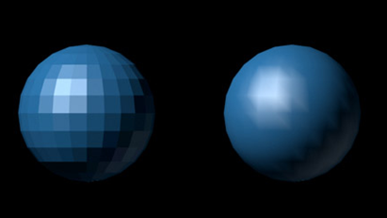
Goals
Better understanding of flat and smooth shading
Making fun shapes
Understanding how light interacts with surfaces via calculations
Notes:
<number>

Slide 3
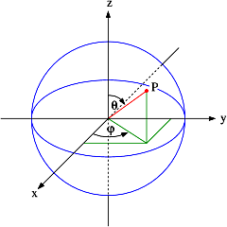
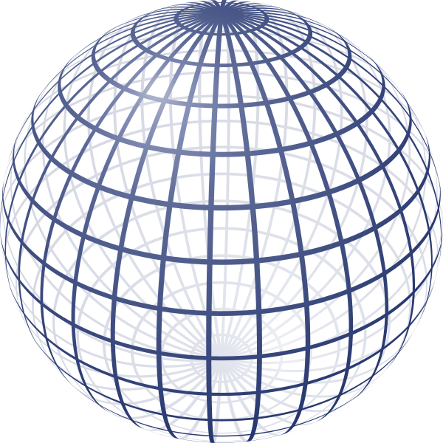
Step 1: Draw your sphere
Decompose a sphere into small polygons
And each polygon has a few vertices
The coordinates of each vertex can be expressed by angle “theta” and “phi”
Notes:
n is the number of sections being drawn
i-variable is in the longtitudinal direction
J-variable is in the latitudinal direction
<number>

Slide 4
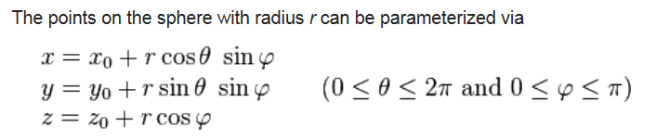
Step 1: Draw your sphere
Go to the function
void drawSphere(double r)
Look into the for-loop
Source: “Sphere” on Wikipedia
Notes:
<number>

Slide 5
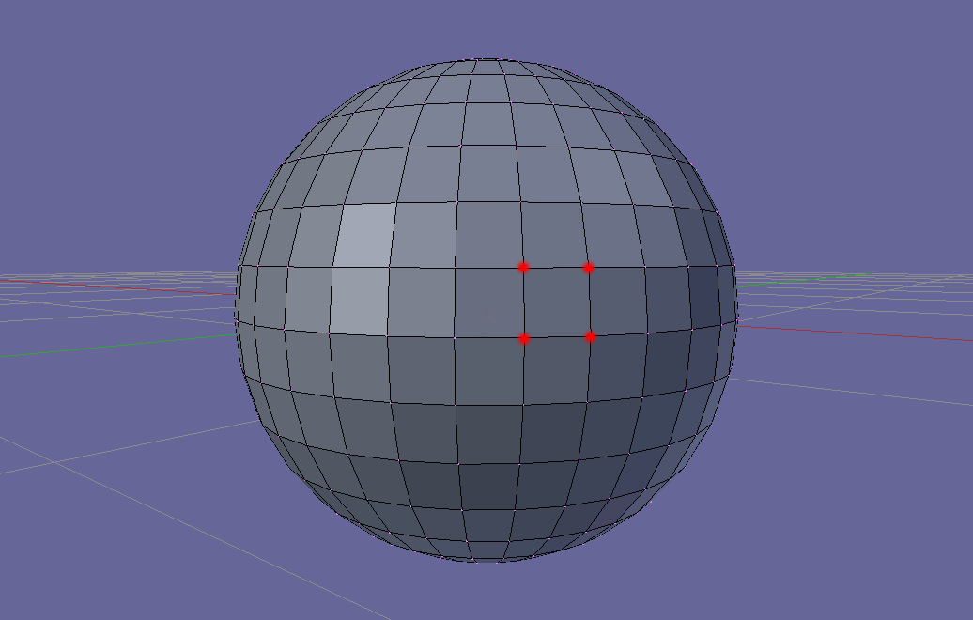
Step 1: Draw your sphere
Variable i is the movement along the latitude
Variable j is the movement along the longtitude
glVertex3d(r*sin(i*M_PI/n)*cos(j*M_PI/n),
r*cos(i*M_PI/n)*cos(j*M_PI/n),
r*sin(j*M_PI/n));
glVertex3d(r*sin((i+1)*M_PI/n)*cos(j*M_PI/n),
r*cos((i+1)*M_PI/n)*cos(j*M_PI/n),
r*sin(j*M_PI/n));
glVertex3d(r*sin((i+1)*M_PI/n)*cos((j+1)*M_PI/n),
r*cos((i+1)*M_PI/n)*cos((j+1)*M_PI/n),
r*sin((j+1)*M_PI/n));
glVertex3d(r*sin(i*M_PI/n)*cos((j+1)*M_PI/n),
r*cos(i*M_PI/n)*cos((j+1)*M_PI/n),
r*sin((j+1)*M_PI/n));
Notes:
<number>

Slide 6

Usually we can follow the lecture slides, computing the vertex normal by the polygons
However, the sphere is a special case - We can compute the normals in an easier manner
The normal vector of a point on a sphere is the unit vector of the point itself
Notes:
n is the number of sections being drawn
i-variable is in the longtitudinal direction
J-variable is in the latitudinal direction
<number>

Slide 7
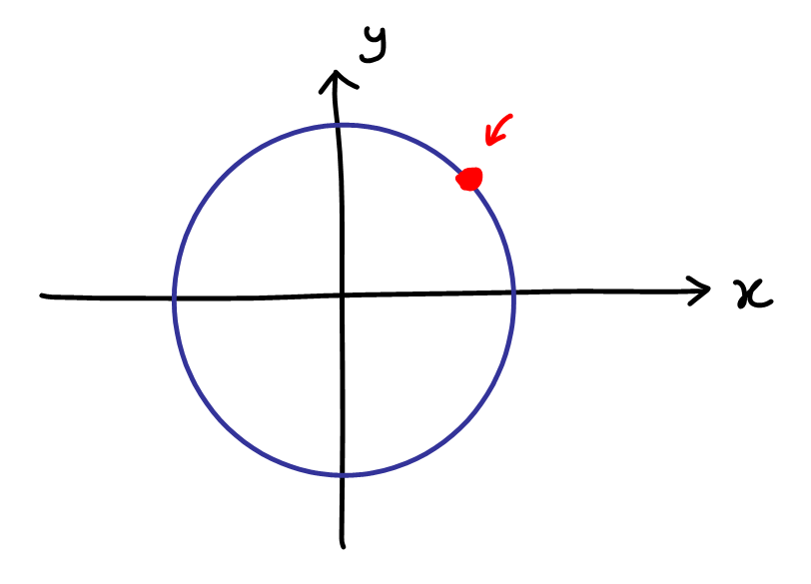
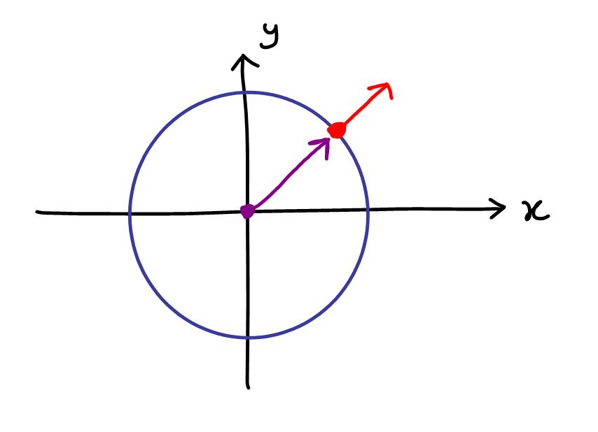
The equation gives us a point on the surface
Vector from origin to point is the normal!
Notes:
n is the number of sections being drawn
i-variable is in the longtitudinal direction
J-variable is in the latitudinal direction
<number>

Slide 8
Step 2: Flat shading
The normal of the whole polygon is the coordinate of the center of the polygon for a sphere
Use the center of polygon to be the normal
glNormal3d(sin((i+0.5)*M_PI/n)*cos((j+0.5)*M_PI/n),
cos((i+0.5)*M_PI/n)*cos((j+0.5)*M_PI/n),
sin((j+0.5)*M_PI/n));
glVertex3d(r*sin(i*M_PI/n)*cos(j*M_PI/n),
r*cos(i*M_PI/n)*cos(j*M_PI/n),
r*sin(j*M_PI/n));
glVertex3d(r*sin((i+1)*M_PI/n)*cos(j*M_PI/n),
r*cos((i+1)*M_PI/n)*cos(j*M_PI/n),
r*sin(j*M_PI/n));
glVertex3d(r*sin((i+1)*M_PI/n)*cos((j+1)*M_PI/n),
r*cos((i+1)*M_PI/n)*cos((j+1)*M_PI/n),
r*sin((j+1)*M_PI/n));
glVertex3d(r*sin(i*M_PI/n)*cos((j+1)*M_PI/n),
r*cos(i*M_PI/n)*cos((j+1)*M_PI/n),
r*sin((j+1)*M_PI/n));
Notes:
<number>

Slide 9
Step 3: Smooth Shading
Set different normal vectors for different vertices
glNormal3d(sin((i+1)*M_PI/n)*cos((j+1)*M_PI/n),
cos((i+1)*M_PI/n)*cos((j+1)*M_PI/n),
sin((j+1)*M_PI/n));
glVertex3d(r*sin((i+1)*M_PI/n)*cos((j+1)*M_PI/n),
r*cos((i+1)*M_PI/n)*cos((j+1)*M_PI/n),
r*sin((j+1)*M_PI/n));
glNormal3d(sin(i*M_PI/n)*cos((j+1)*M_PI/n),
cos(i*M_PI/n)*cos((j+1)*M_PI/n),
sin((j+1)*M_PI/n));
glVertex3d(r*sin(i*M_PI/n)*cos((j+1)*M_PI/n),
r*cos(i*M_PI/n)*cos((j+1)*M_PI/n),
r*sin((j+1)*M_PI/n));
glNormal3d(sin(i*M_PI/n)*cos(j*M_PI/n),
cos(i*M_PI/n)*cos(j*M_PI/n),
sin(j*M_PI/n));
glVertex3d(r*sin(i*M_PI/n)*cos(j*M_PI/n),
r*cos(i*M_PI/n)*cos(j*M_PI/n),
r*sin(j*M_PI/n));
glNormal3d(sin((i+1)*M_PI/n)*cos(j*M_PI/n),
cos((i+1)*M_PI/n)*cos(j*M_PI/n),
sin(j*M_PI/n));
glVertex3d(r*sin((i+1)*M_PI/n)*cos(j*M_PI/n),
r*cos((i+1)*M_PI/n)*cos(j*M_PI/n),
r*sin(j*M_PI/n));
Let’s try it all together
Notes:
<number>

Slide 10
Changing Lighting and Material Properties
Notes:
<number>

Slide 11
Lighting
In the function “setupLighting”, basic lights and materials have already been set up for you
glShadeModel(GL_SMOOTH);
// Lights, material properties
GLfloat ambientProperties[] = {0.7f, 0.7f, 0.7f, 1.0f};
GLfloat diffuseProperties[] = {0.8f, 0.8f, 0.8f, 1.0f};
GLfloat specularProperties[] = {1.0f, 1.0f, 1.0f, 1.0f};
GLfloat lightPosition[] = {-100.0f,100.0f,100.0f,1.0f};
glLightfv( GL_LIGHT0, GL_POSITION, lightPosition);
glLightfv( GL_LIGHT0, GL_AMBIENT, ambientProperties);
glLightfv( GL_LIGHT0, GL_DIFFUSE, diffuseProperties);
glLightfv( GL_LIGHT0, GL_SPECULAR, specularProperties);
glLightModelf(GL_LIGHT_MODEL_TWO_SIDE, 0.0);
// Default : lighting
glEnable(GL_LIGHT0);
glEnable(GL_LIGHTING);
k_{a}, k_{d}, k_{s} in the lecture notes (the last entry is “alpha” for transparency)
1.0 for NOT at infinity
You can set more then 1 light
Lighting not in effect if you don’t enable it
Notes:
<number>

Slide 12
Changing Material Properties for EACH OBJECT
Try looking into the function drawSphere again
float mat_ambient[] = {0.8f, 0.8f, 0.2f, 1.0f};
float mat_diffuse[] = {0.1f, 0.5f, 0.8f, 1.0f};
glMaterialfv(GL_FRONT, GL_AMBIENT, mat_ambient);
glMaterialfv(GL_FRONT, GL_DIFFUSE, mat_diffuse);
Set up the colors for different properties (ambient, diffuse, specular)
Let’s try to change the ball into red color?
Notes:
<number>

Slide 13
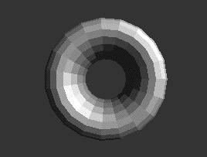
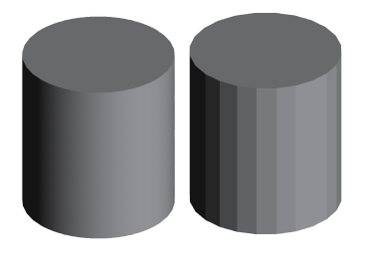
Step 4 : Create another shape
Draw more fun shapes! Torus, Hearts, cylinders, cones, etc.
Your shape must have some curved surface!
Do not use pre-defined functions eg. drawSolidSphere() provided by GLUT
Notes:
<number>

Slide 14
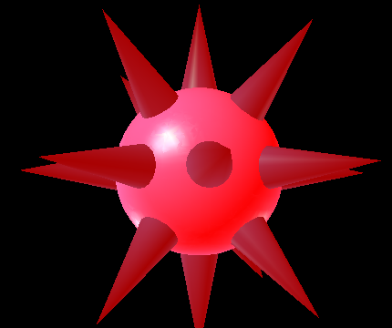
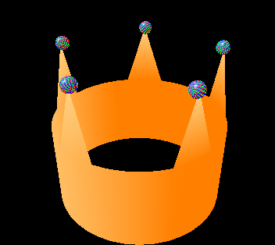
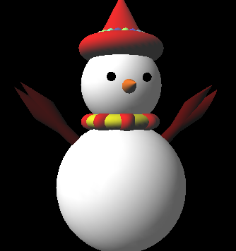
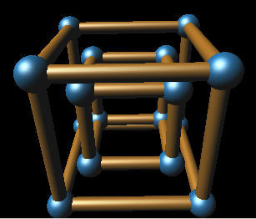
Step 5 : Composite Objects
Compose your primitive objects to form unique shapes
Notes:
<number>

Slide 15
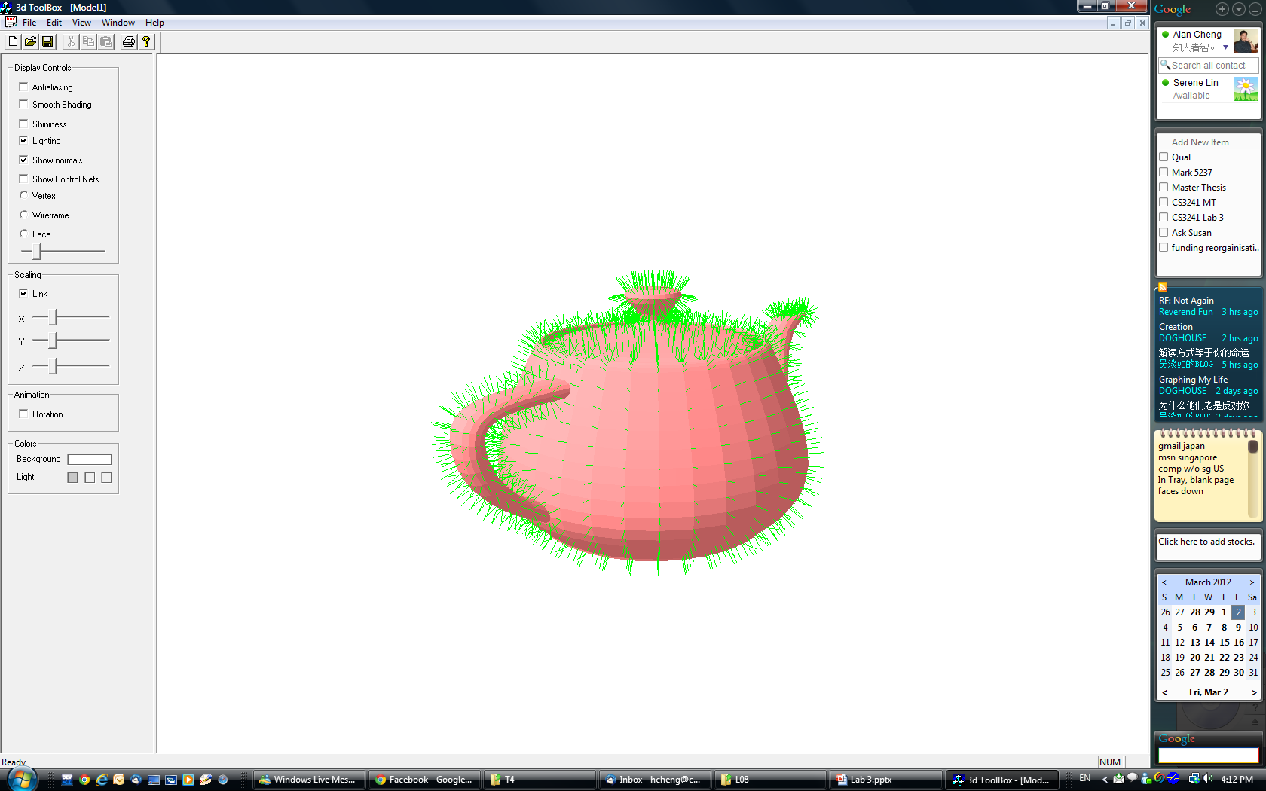
Some small tips
If your program runs slow, try to eliminate square roots or power functions
These functions are really expensive and will slow down your program
If you cannot figure out the normals, draw them out to visually confirm that they are correct
Notes:
<number>

Slide 16
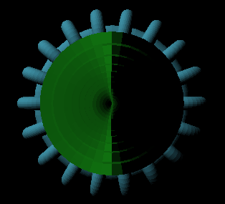
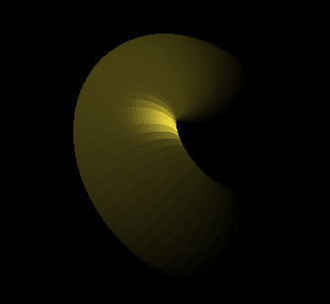
Examples of bad/half-lit shading
This is normally caused by normals that are calculated wrongly or point inwards
Notes:
<number>

